Slide 1
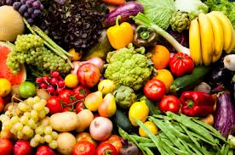

Slide 2
Hand. 2:40
“Met nog baie ander woorde het Petrus getuig en hulle aangespoor: "Laat julle red tussen hierdie ontaarde mense uit.”

Slide 4
I Kor 10:1-6

Slide 6
Joh 6:56
“Wie my liggaam eet en my bloed drink, bly in My en Ek in hom.”

Slide 8
“It is an offence to God to let our desires go beyond our faith.”
Hendry

Slide 9
“We should not indulge ourselves in any desire which we cannot in faith turn into prayer, as we cannot when we ask meat for our lust”
Hendry

