Slide 1
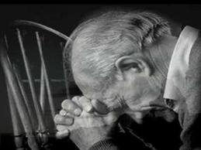

Slide 2
“...the presence of sin makes the presence of God impossible.”
Andrew Murray

Slide 3
1:
God se teenwoordigheid is 'n voorreg en hulle enigste wapen teen die vyand:

Slide 4
Eks. 33:16
“Hoe sal die mense weet dat ek en u volk u goedgesindheid geniet as U nie saam met ons gaan nie? Dit is juis deurdat U met ons saamgaan dat ons, ek en u volk, anders is as al die ander volke op die aarde."

Slide 5
2:
Verloor en verlies is as gevolg van verlies aan God se teenwoordigheid:

Slide 6
3:
Verlies van God se teenwoordigheid is altyd as gevolg van verborge sonde:

Slide 7
4:
God self wys die verborge sonde:

Slide 8
Ps. 139:23
“Deurgrond my, o God, deurgrond my hart, ondersoek my, sien tog my onrus raak.”

Slide 9
4:
God self wys die verborge sonde:

Slide 10
“It is not a question of what you can do. It is a question of whether, with your whole heart, you give God what is due Him, surrendering yourself to let His will and grace have their way with you.”
Andrew Murray

Slide 11
5:
As God dit openbaar, moet dit hanteer word:

Slide 12
6:
As sonde weg is, is God se teenwoordigheid terug:

Slide 13
“God never speaks to His people about sin except with the purpose of saving them from it.”
Andrew Murray

