Slide 1
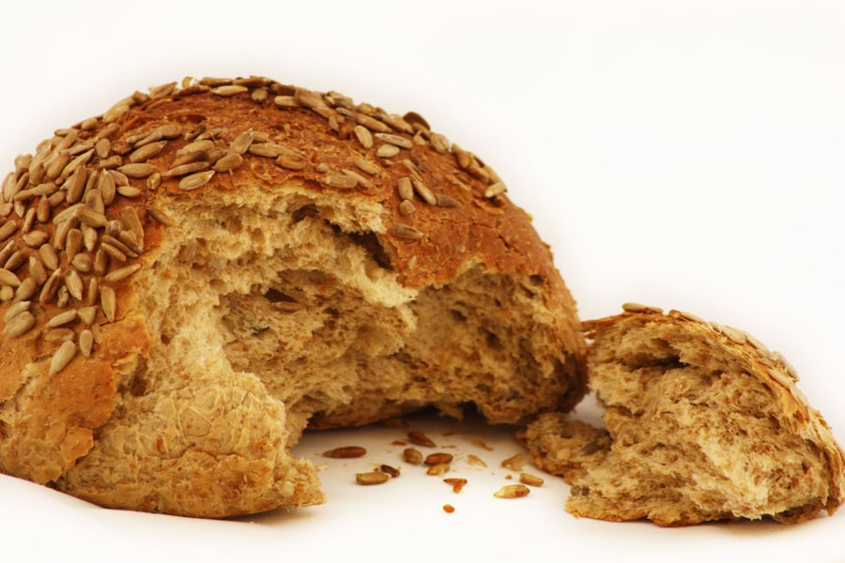

Slide 2
“Many Christians have just enough religion to be miserable. They are like this crowd, missing God's gift of life in his Son.”
John Wesley

Slide 4
“That He should give it is much; that He should be it is far more.”
Alexander Maclaren

Slide 6
“Sacrifice for sins is the food on which a sinful and cleansed world may feed.”
Alexander Maclaren

