Slide 1
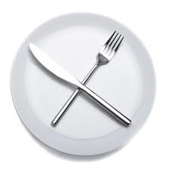

Slide 2
Matt. 9:15
“Jesus antwoord hulle: "Kan die bruilofsgaste dan treur solank die bruidegom nog by hulle is? Maar daar kom ‘n tyd wanneer die bruidegom van hulle weggeneem sal word, en dan sal hulle vas.”

Slide 4
“Fasting means an abstinence from food for the sake of certain special purposes such as prayer or meditation or the seeking of God for some peculiar reason or under some exceptional circumstance.”
Martyn Lloyd-Jones

