Slide 1
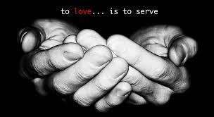

Slide 2
1 Kor. 9:16
“As ek die evangelie verkondig, is dit nie vir my ‘n rede om te roem nie. Ek verkondig die evangelie omdat ek móét! En wee my as ek dit nie doen nie!”

Slide 4
“A Christian who has lost the joy of the ministry does not have bad circumstances, but bad connections.”
John MacArthur

