Slide 1
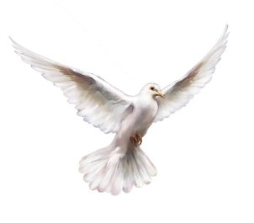

Slide 2
Luk 14:33
"So kan niemand van julle my dissipel wees as hy nie bereid is om van al sy besittings afstand te doen nie.“

Slide 3
“The spirit of the world has penetrated into us so deeply that we are not aware of it. We share in its desire for comfort and enjoyment, for self-pleasing and self-exaltation, without realizing how impossible these things make it for us to be filled with the Spirit.”
Andrew Murray

Slide 5
Ef. 5:18
“Moet julle nie aan drank te buite gaan nie; daarmee gaan losbandigheid gepaard. Nee, laat die Gees julle vervul”

Slide 7
“Experience is simply the door through which salvation comes into the conscious level of our life so that we are aware of what has taken place on a much deeper level.”
Oswald Chambers

